Slide 1

Team NAME: The Disruptors
Project: Instant Payment Gateway using QR
and 3 payment options
Kostas Banakakis|Konstantinos Kehagias|Vagelis Fragkos|Giorgos Maismaz

Slide 2
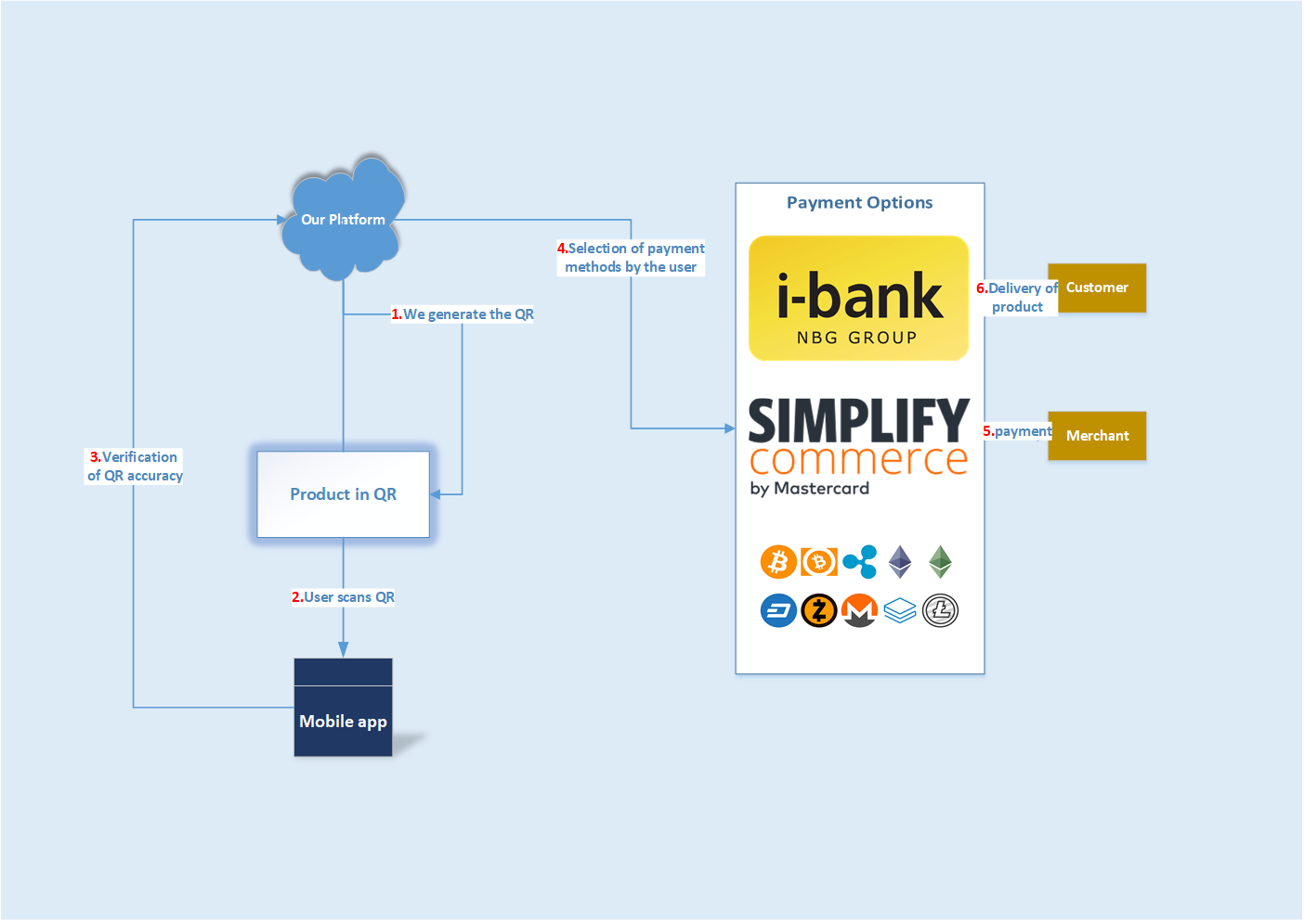
How does it work?

Slide 3
Market facts
80% of the Internet usage in 2018 will be on mobile
30% of e-commerce in Greece is actually mobile

Slide 4





Languages used

Slide 5

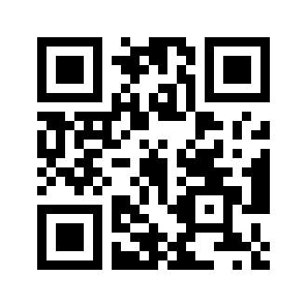
Scan me
Limited time offer

Slide 6
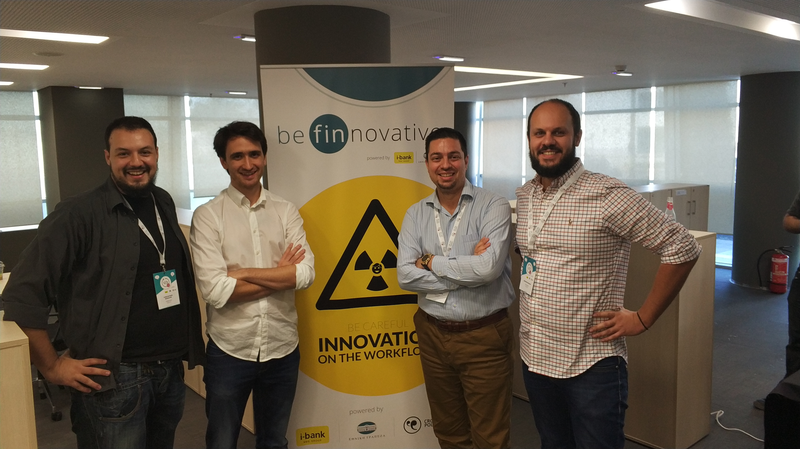
Kostas Banakakis|Konstantinos Kehagias|Vagelis Fragkos|Giorgos Maismaz
Software Engineer,
Game Developer,
Data Scientist
Software Engineer,
BSc National Kapodistrian University of Athens
MSc Computing Systems Software & Hardware
Maritime Supply Manager & ICT
BSc in Computer Science
MSc in Management
Senior Software Engineer, Certified Scrum Master

